Slide 1
PROJECT WORKSHOP
BY B SINDHYA B009
SIREESHA BASAMSETTY B011
MANISHA DEWAL B022

Slide 2
INTRODUCTION
The basic purpose of this android application is to improve connectivity between the faculty and the students.
This application can be used by teachers to search for various students or branches or other teachers.
It can be used by students as well, to search for various teachers or branches.
This also helps students or teachers find their way within the college.
This will not only help students but also the teachers.

Slide 3
The application currently focuses only on the institute of MPSTME.
This application doesn’t make use of GPS. The user, if lost, needs to enter whatever near by location they see to be guided to their respective destination.
This application can only track where a specific branch will be and not any specific student within that specific branch.
Also this only covers the teachers who are permanently a part of our college and not visiting faculty of our college.

Slide 4
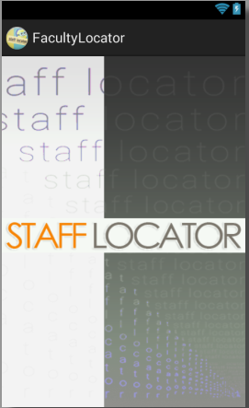
NEW GRAPHICAL INTERFACE
1. COVER

Slide 5
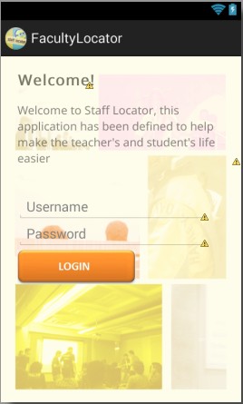
2. LOGIN

Slide 6
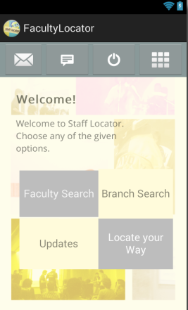
3. HOME PAGE

Slide 7
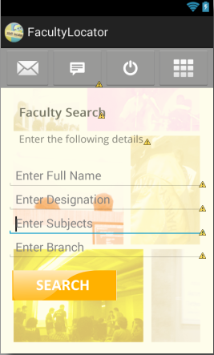
4. FACULTY SEARCH

Slide 8
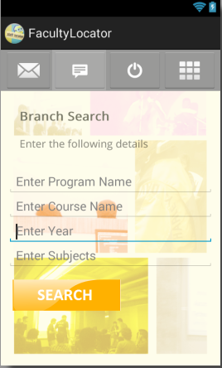
5. BRANCH SEARCH

Slide 9
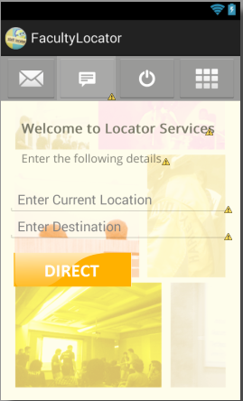
6. FIND YOUR WAY

Slide 10
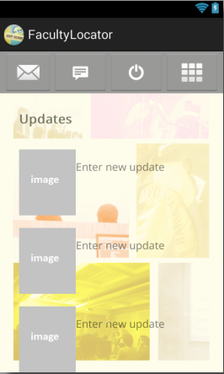
7. UPDATES

Slide 11
SWISH
These are .swf files that are animated videos created using swish macx.
These video files show a mapping of the floor with each component, a line directs the user from the source to the destination depending upon the option they choose using the pop up menu.

Slide 12
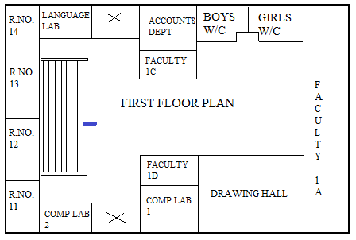

Slide 13
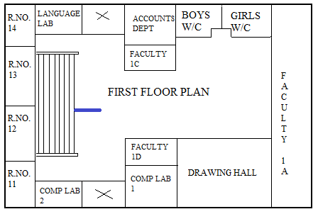

Slide 14
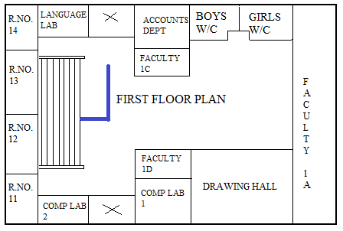

Slide 15
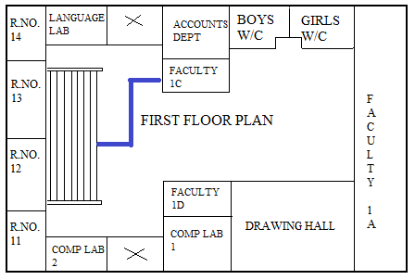

Slide 16
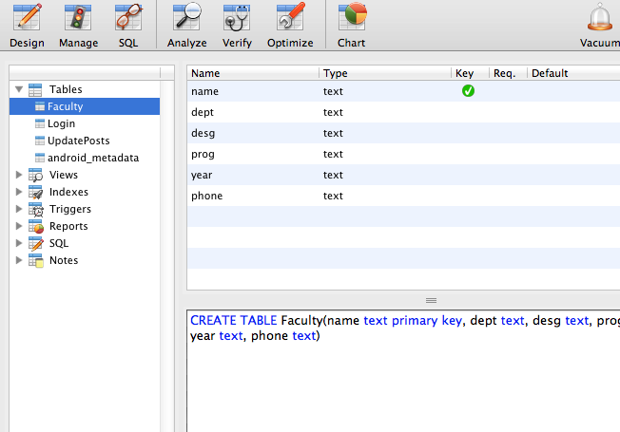
DATABASES
FACULTY SCHEMA

Slide 17
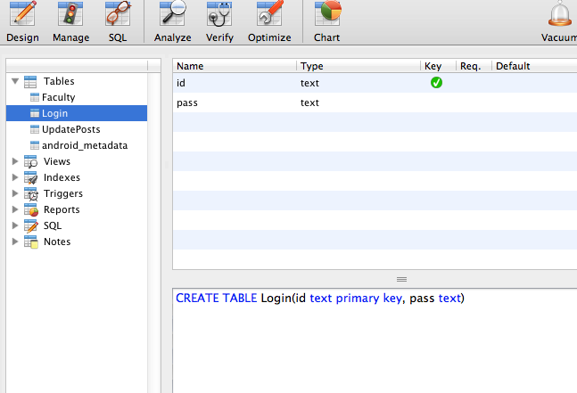
LOGIN SCHEMA

Slide 18
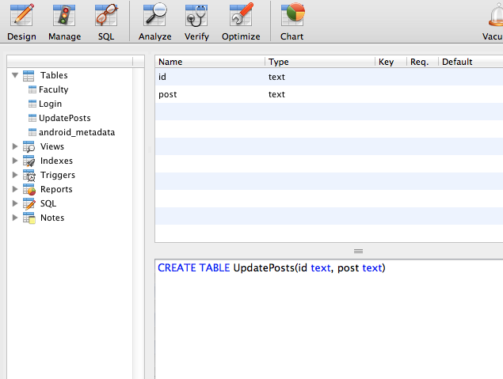
UPDATE SCHEMA

Slide 19
CONCLUSION
This project is basically about bridging the distance between the students and the teachers.
This application consists of various aspects such as search, find your way.
The filtered search will pop up with a list of teachers who fit your criterion or a branch depending upon the option you choose.
The locator will be depending upon any markers around you.

Slide 20
THANK YOU

